Slide 1
Sensors and Automation (Interdisciplinary Foundation Course–II) Theory Session
Electrical Transducers/Sensors
Resistance type
Inductive Type
Capacitive Type

Slide 2
Resistive transducers are sensors that convert physical quantities such as force, pressure, or strain into changes in electrical resistance.
These transducers are based on the principle that the resistance of a material changes when it is subjected to a physical force or pressure.
Application: Aerospace, Automotive, Medical industries, for measuring and controlling physical quantities.
Types: 1. Potentiometric Type
2. Strain Gauge Type

Slide 3
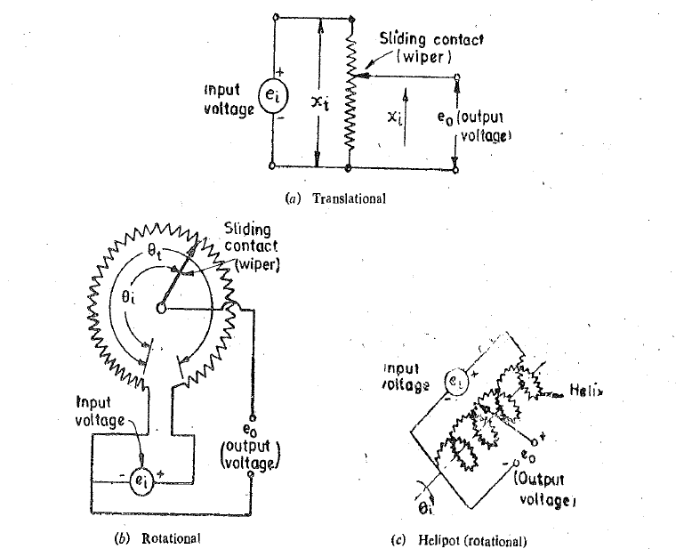
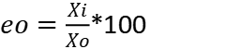
1. Potentiometric Type: Displacement into Electrical signal
$eo=\frac{Xi}{Xo}$*100

Slide 4
2.Strain gauges:
These are used to measure the strain or deformation in a material caused by a physical force or pressure.
Strain gauges are typically made of a thin wire or foil of a material such as nickel or copper, which is mounted on a flexible backing material.
As the material is subjected to strain, the wire or foil is stretched or compressed, which changes its resistance. This change in resistance can be measured and used to calculate the strain.

Slide 5
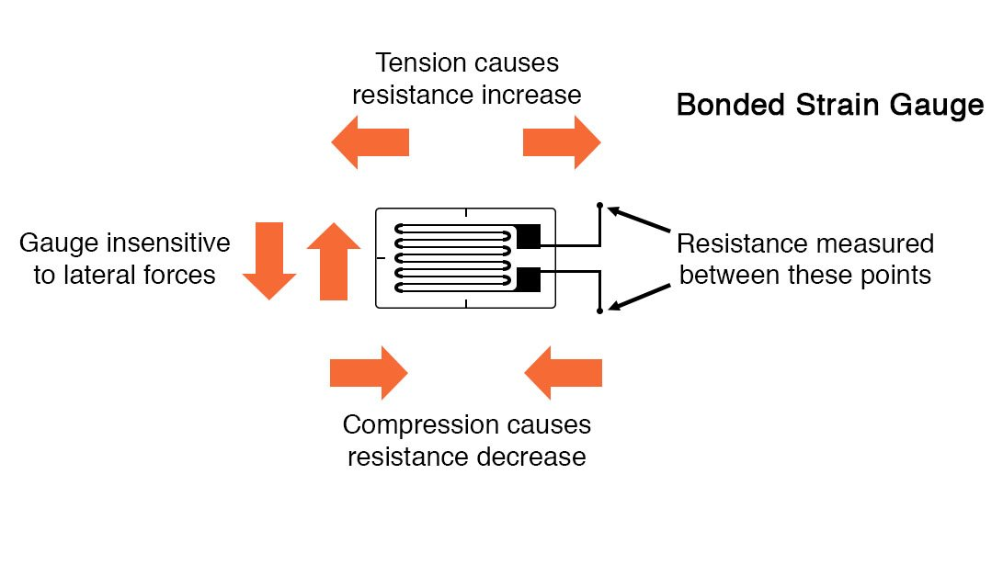
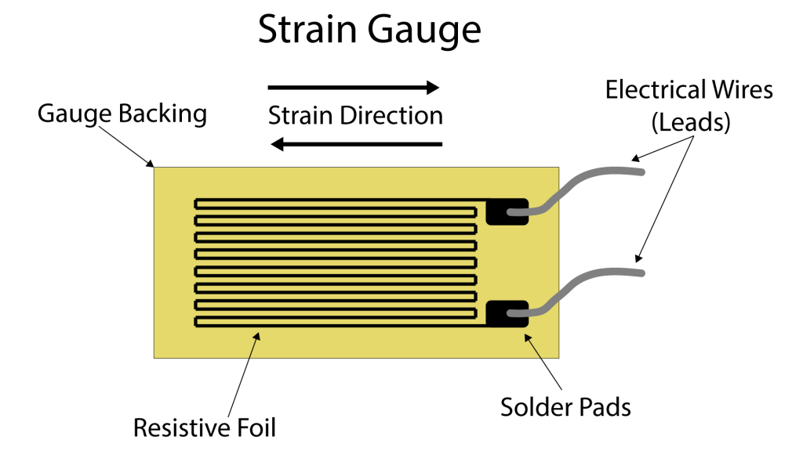

Slide 6
A strain gauge’s conductors are very thin: if made of round wire, about 1/1000 inch in diameter.
Alternatively, strain gauge conductors may be thin strips of the metallic film deposited on a nonconducting substrate material called the carrier.
Typical strain gauge resistances range from 30 Ω to 3 kΩ (unstressed)

Slide 7
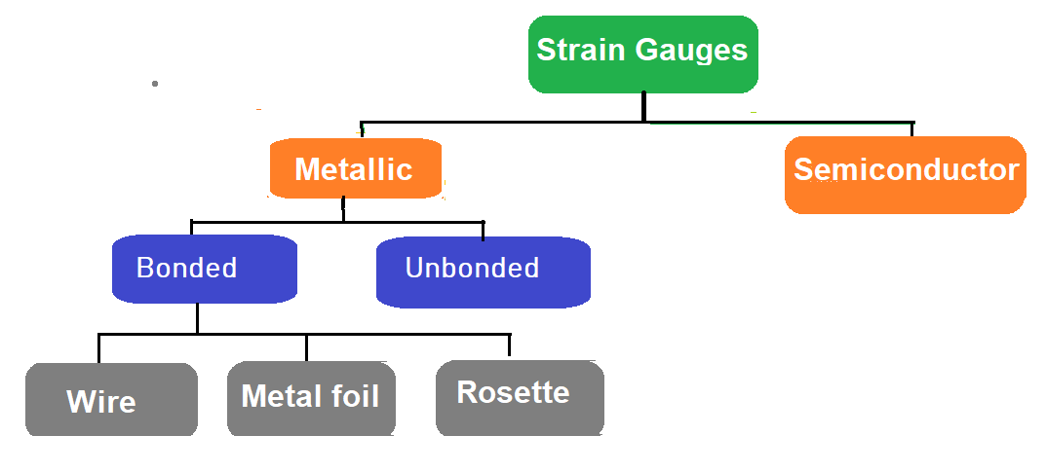
Types of Strain Gauges

Slide 8
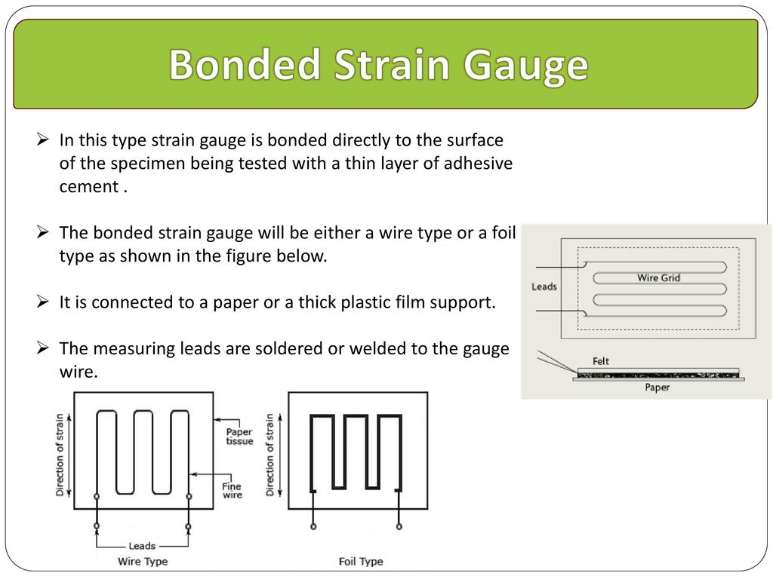
Metalic Strain Gauges

Slide 9
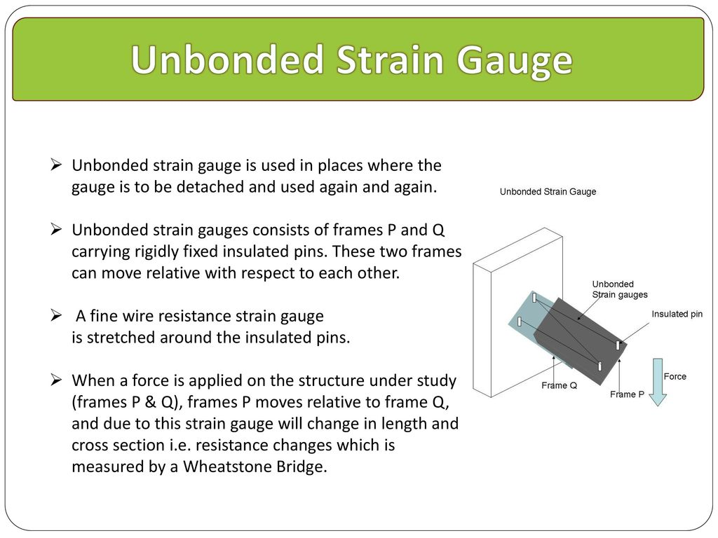

Slide 10
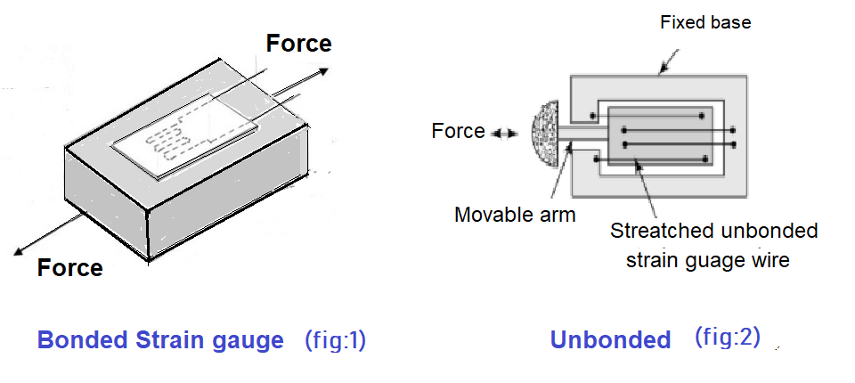

Slide 11
Application of Unbonded strain gauge:
Places where the gauge is to be detached and used again and again.
Force, pressure and acceleration measurement.
Advantages of Unbonded strain gauge:
The range of this gauge is +/- 0.15% strain.
Very high accuracy.

Slide 12
Semi Conductor Strain Gauge: Piezo -Resistive Strain Gauge
The sensing element is rectangular filament made as a wafer from silicon or geranium crystals.
To these crystals, boron is added to get some desired properties and this process is called doping and the crystals are called doped crystals.
There are two types of sensing element namely:
Negative or n-type (resistance decrease with respect to tensile strain).
Positive or P-type ( resistance increase with respect to tensile strain).

Slide 13
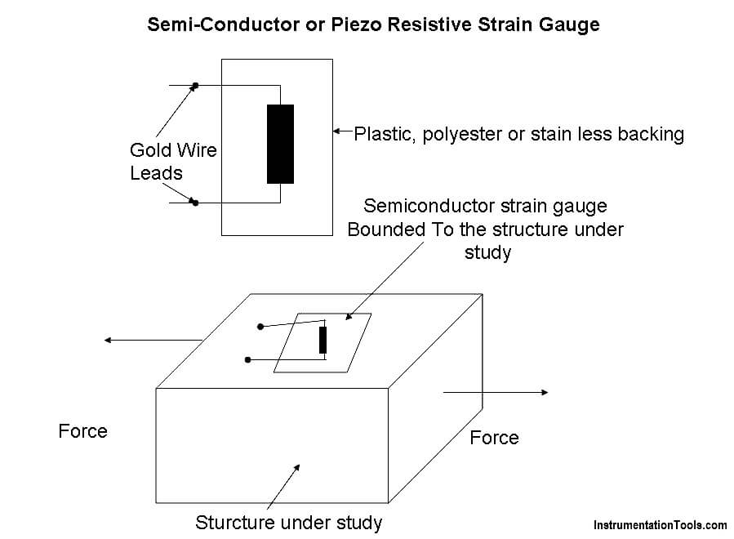

Slide 14
Working :
With the help of an adhesive material, the strain gauge is pasted/bonded on the structure under study.
Now the structure is subjected to a force (tensile or compresive).
Due to the force, the structure will change the dimension.
As the strain gauge is bonded to the structure, the strain gauge will also undergo change in both in length and cross-section (that is, it strained).

Slide 15
Advantages:
High gauge factor and hence they can measure very small strains.
Manufactured to very small sizes.
Accuracy of 2.3%
Excellent hysteresis characteristics.
Good frequency of response.
Good fatigue life.
Limitation:
These gauges are brittle and hence they cannot be used for measuring large strain.
Gauge factor is not constant.
Have poor linearity.
Very costly and are difficult to be bonded onto the structure under study.
Sensitive to change in temperature.

Slide 16
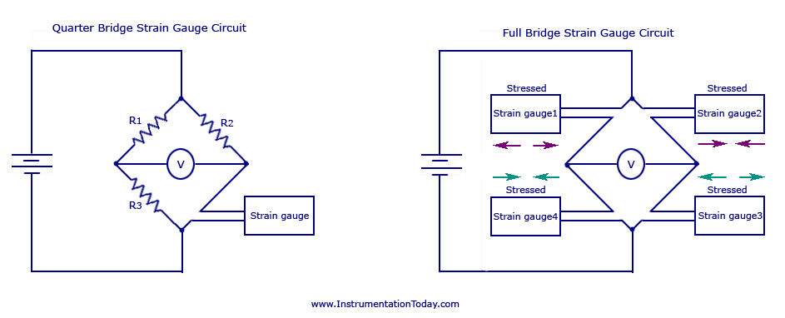
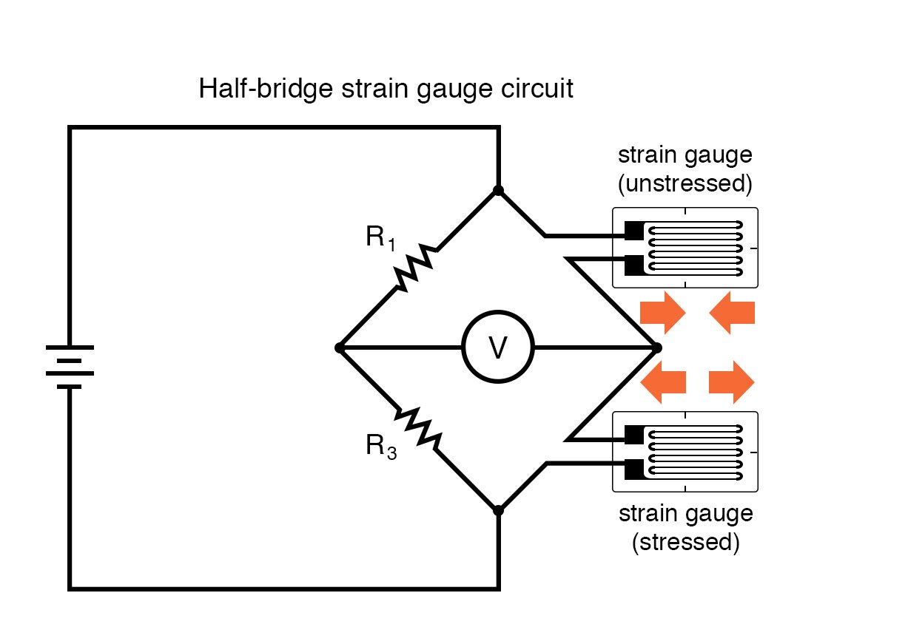
Configurations used for SG: Bridge Measurement Circuit

Slide 17
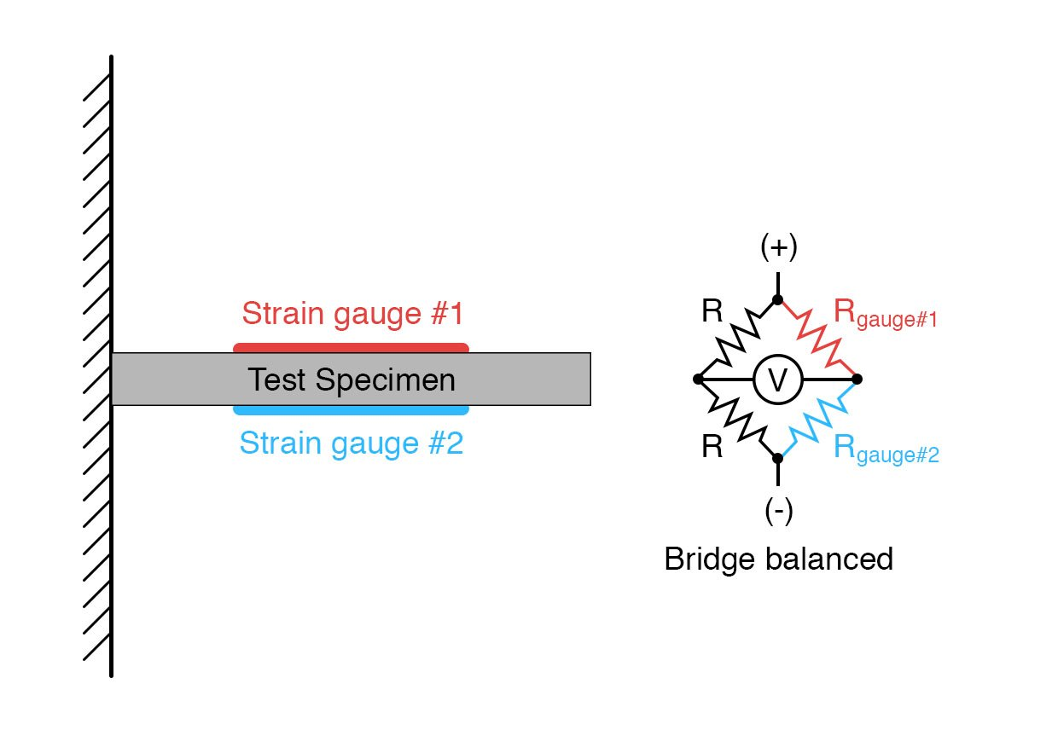
Application of Strain Gauges
An example of how a pair of strain gauges may be bonded to a test specimen so as to yield this effect is illustrated here:
With no force applied to the test specimen, both strain gauges have equal resistance, and the bridge circuit is balanced.

Slide 18
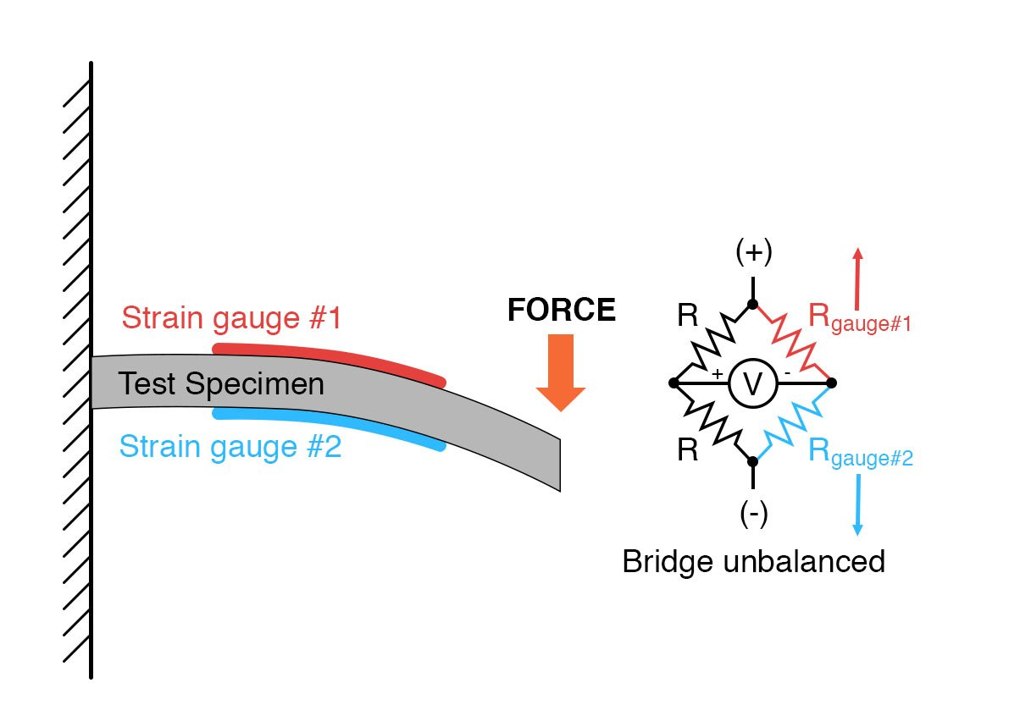
However, when a downward force is applied to the free end of the specimen, it will bend downward, stretching gauge #1 and compressing gauge #2 at the same time:

Slide 19
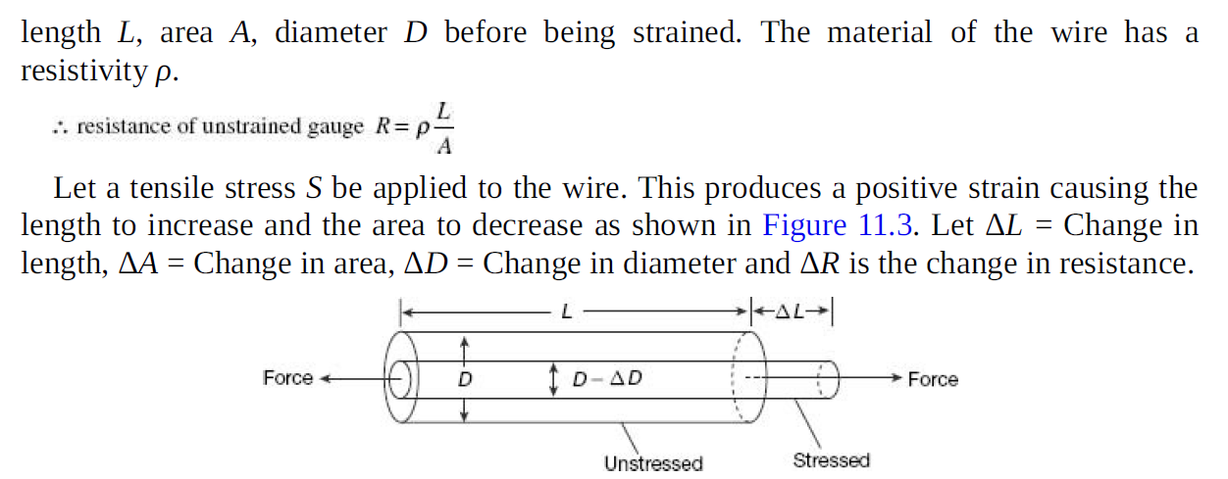
Analysis of SG : Gauge Factor
Let us consider SG made of circular wire. The wire has dimensions

Slide 20
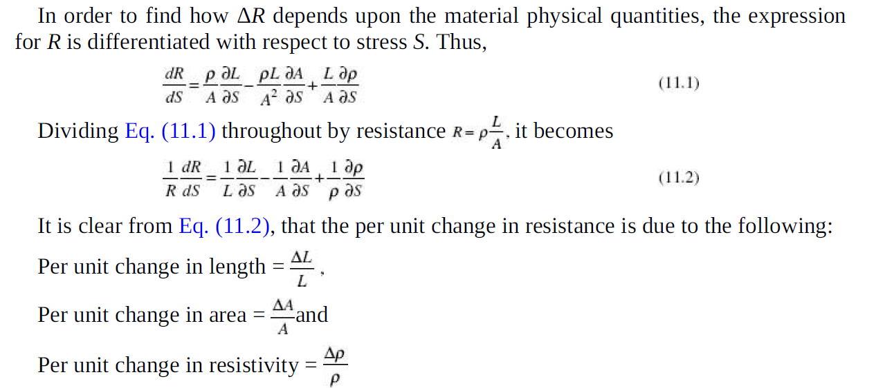

Slide 21
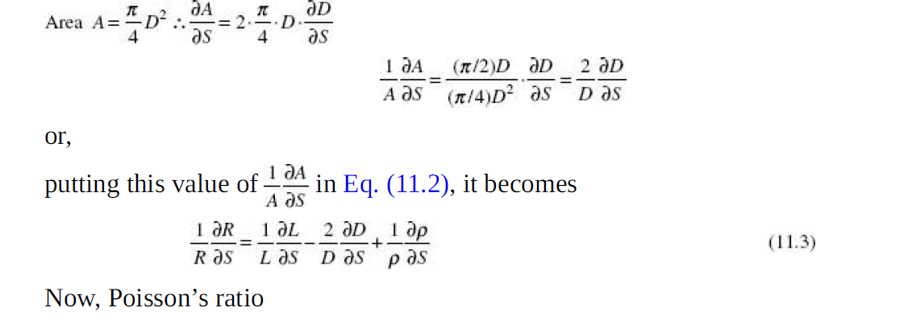

Slide 22
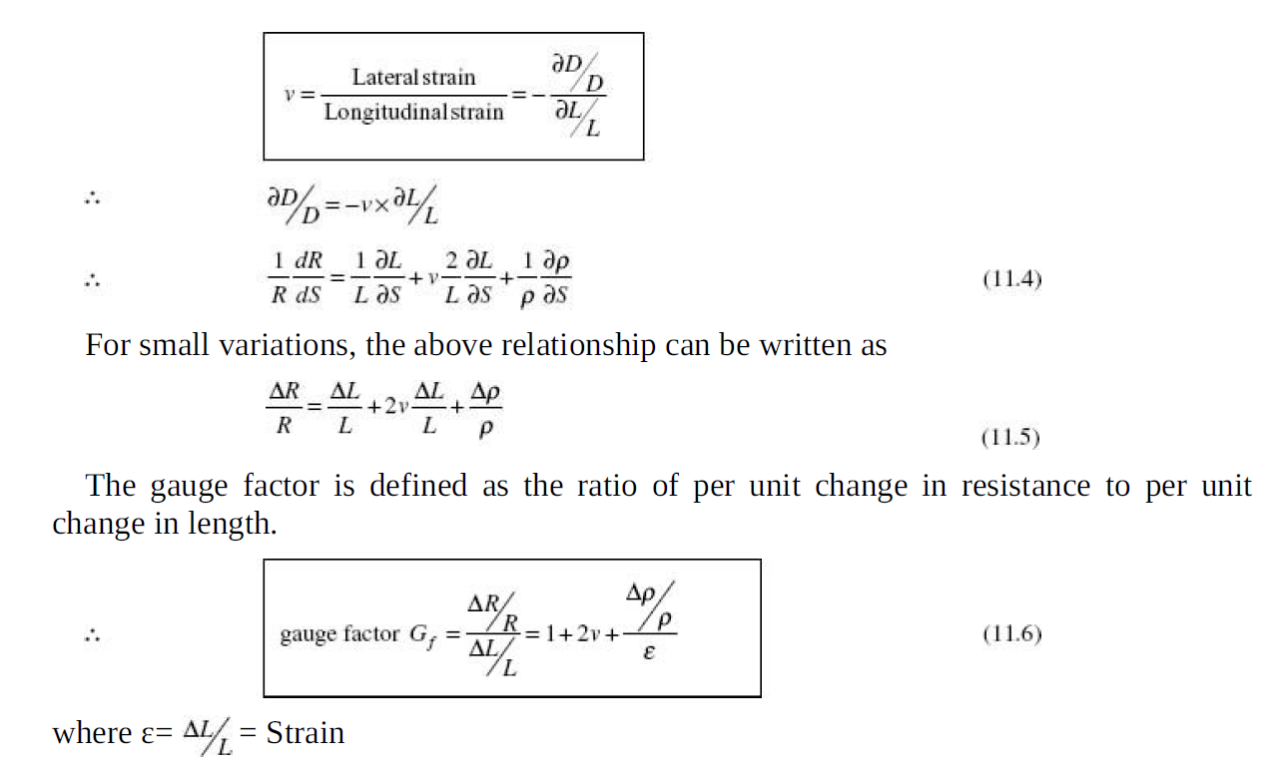

Slide 23
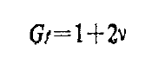
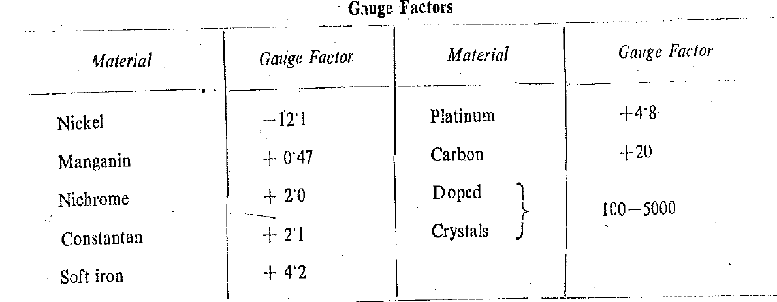

Slide 24
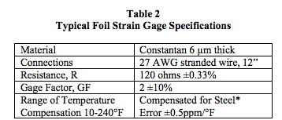

Slide 25
Inductive Type Transducers
1. Self generating Type
2. Non self generating Type

Slide 26
Self generating Type
Self-generating inductive transducers are devices that can convert mechanical energy into electrical energy.
They typically consist of a coil of wire and a magnet that moves relative to the coil. When the magnet moves, it creates a changing magnetic field that induces an electric current in the coil.
Applications:
Power generation, sensing, and control.
They are typically simple and reliable
Making them ideal for use in harsh environments
Applications where maintenance is difficult or impossible.

Slide 27
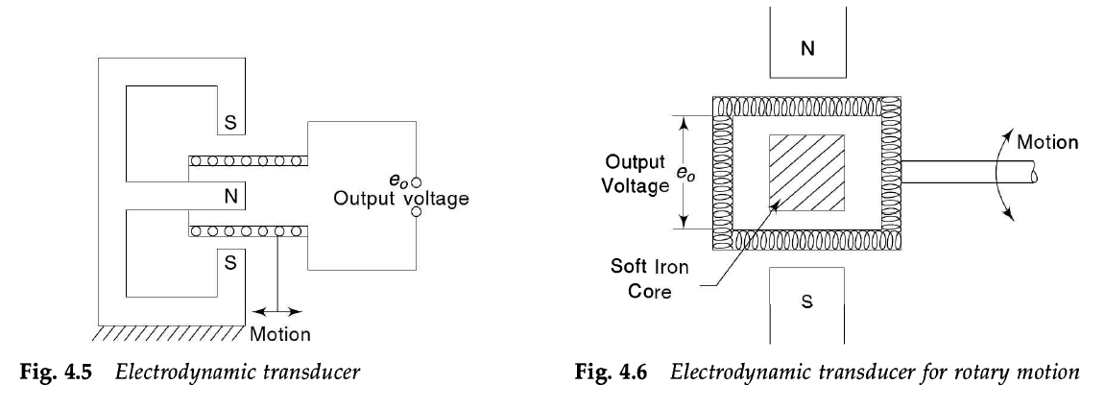

Slide 28
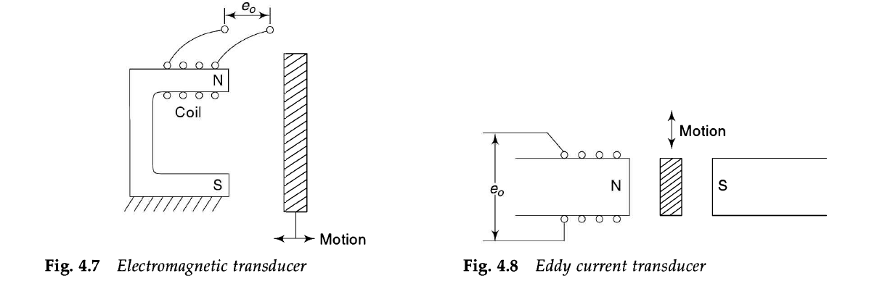
Eddy current transducers are sensors that use eddy currents to measure various parameters, such as
Distance, position, vibration, conductivity, and thickness.
Eddy currents are small circulating electrical currents that are induced in a conductive material when it is placed in a changing magnetic field.

Slide 29
The basic principle of operation of eddy current transducers involves generating a high-frequency alternating magnetic field using a coil and measuring the eddy currents induced in a nearby conductive material.
The magnitude and phase of these eddy currents are dependent on the properties of the material, such as its conductivity, permeability, and thickness.
Eddy current transducers are used in a variety of applications, such as non-destructive testing, flaw detection, material sorting, and position sensing.
Application in harsh environments, such as high temperatures or corrosive conditions.

Slide 30
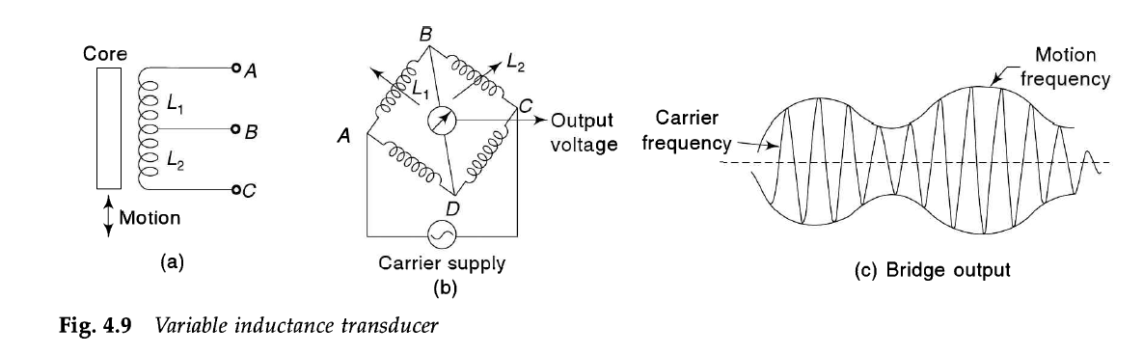
Non-self-generating transducers are devices that require an external power source to operate.

Slide 31
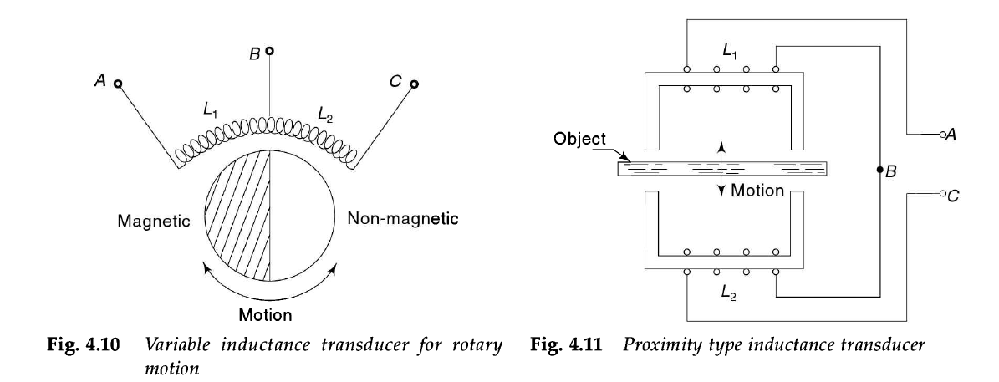

Slide 32
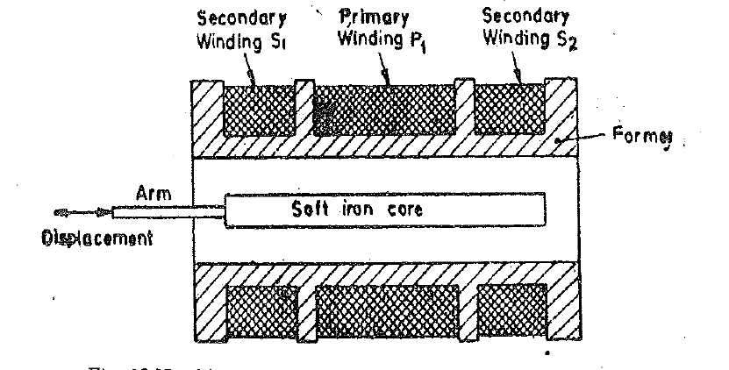
LVDT: Construction

Slide 33
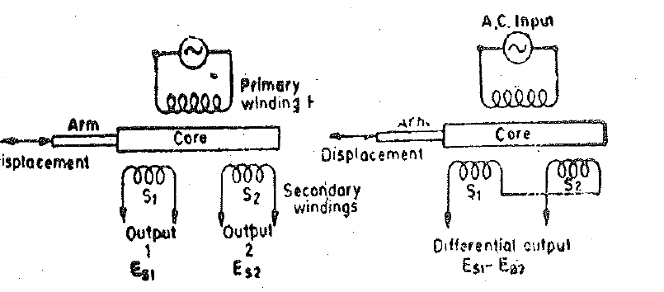
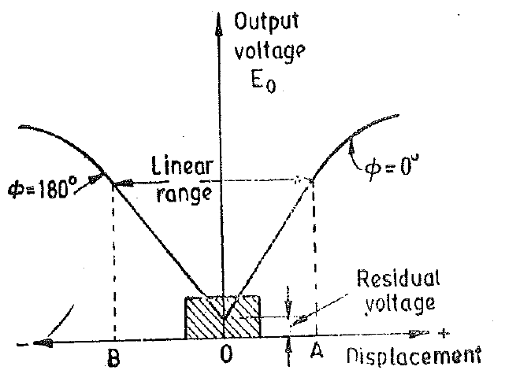
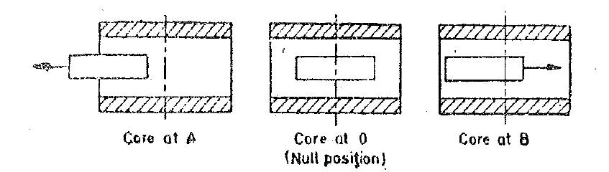
LVDT: Working
LVDT :Characteristics

Slide 34
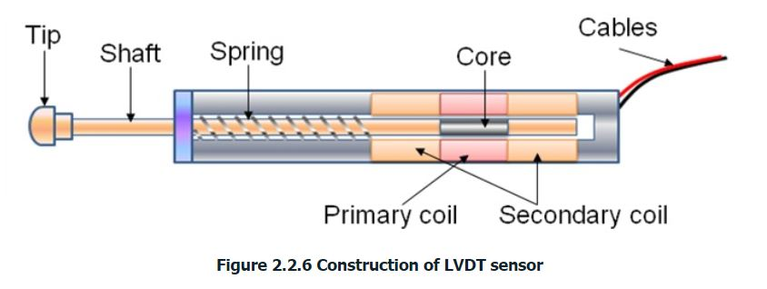
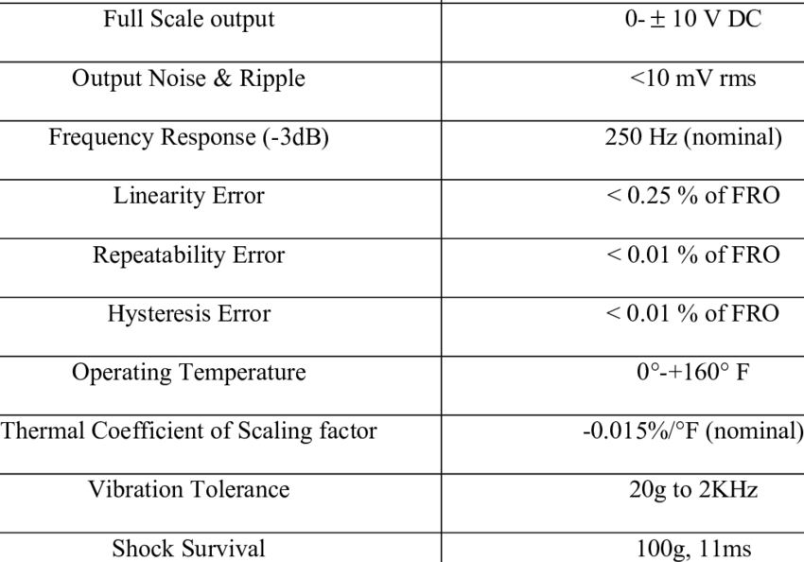
LVDT

Slide 35
3.Capacitive Type
Capacitive transducers are devices that convert mechanical changes into measurable electrical signals.
They work by using changes in capacitance, which is the ability of a system to store an electric charge, to detect changes in physical parameters such as displacement, pressure, or force
Applications
Pressure sensors
Displacement sensors
Accelerometers
Force sensors.

Slide 36
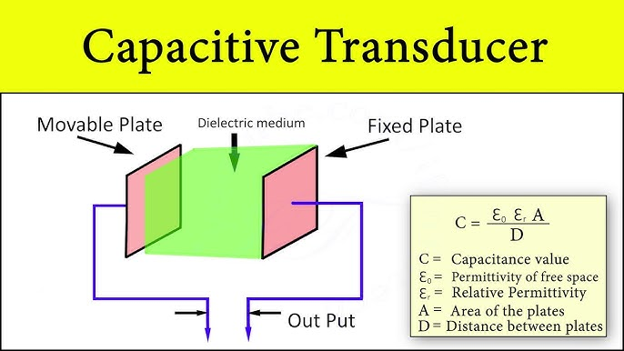

Slide 37
Types of Capacitive Transducer
According to the structure of the capacitive transducer, they are four types which are discussed below. They are
Parallel plate capacitance with rectangular plates.
Cylindrical capacitor transducer.
Semi circular parallel plates.
Change in dielectric between parallel plates.

Slide 38
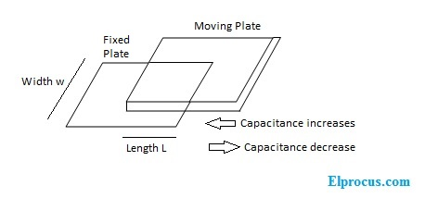
1.Parallel Plate Capacitance with Rectangular Plates
This is also called a flat type of capacitive transducer. In this type of transducer, one plate is fixed, and the other plate can be moved. By this variation, the distance d or area A can be varied. This results in the capacitance value of this transducer.

Slide 39
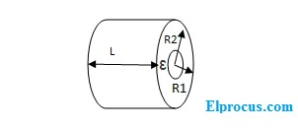
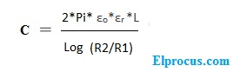
2.Cylindrical Capacitive Transducer
Considering the length of the cylinder is to be L, then the capacitance

Slide 40
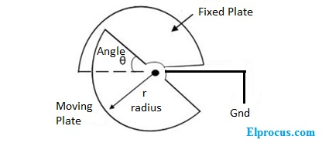
3.Semi Circular Capacitive Transducer
This type will provide the highest capacitance value when the two capacitive plates are overlapped to each other. These are preferable when the circuit requires the maximum capacitance.
In this type capacitive transducer, area A = πr^2/2 and the capacitance C=ε πr^2/2d

Slide 41
4.Change in Dielectric Medium between Parallel Plates
When the dielectric medium varies between the two parallel plates of this transducer, that also varies the capacitance of the transducer.
capacitance C= εo (ε1*L1*w + ε2*L2*w)/d
Where – L1 and L2 are indicating the length of the 1st and 2nd plates length.
W indicates the width of the plate
D indicates the distance between the plates

Slide 42
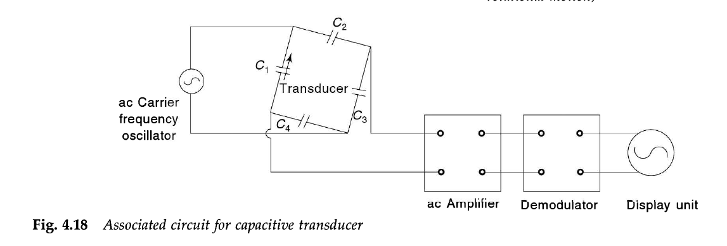
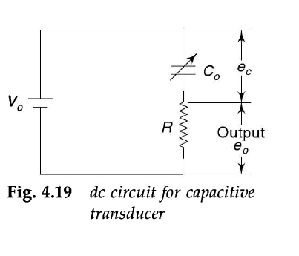
Capacitive Transducer Circuit

Slide 43
Advantages
High input impedance. So, the loading effects value will be too low.
The frequency response of these transducers is extremely high.
Highly sensitive.
This transducers are called low power consuming devices.
High resolution can be possible by using these transducers.
Disadvantages
It has a high output impedance.
These transducers exhibit non-linear behaviors due to edge effects.
The external temperature value can affect this transducer capacitance value.
Applications
Displacement, Humidity, Pressure measurement

Slide 44
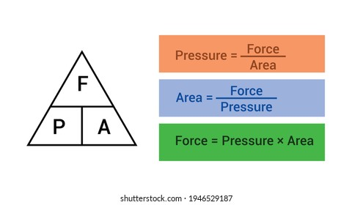
Pressure Transducers
Pressure transducers are devices used to measure and convert pressure into an electrical signal.
Pressure transducers typically consist of a sensing element that responds to changes in pressure and a signal-conditioning circuit that amplifies and converts the sensing element's output into an electrical signal.
The sensing element can be a piezoelectric crystal, strain gauge, or capacitive element, among others.
Applications:
Industrial
Automotive
Medical

Slide 45
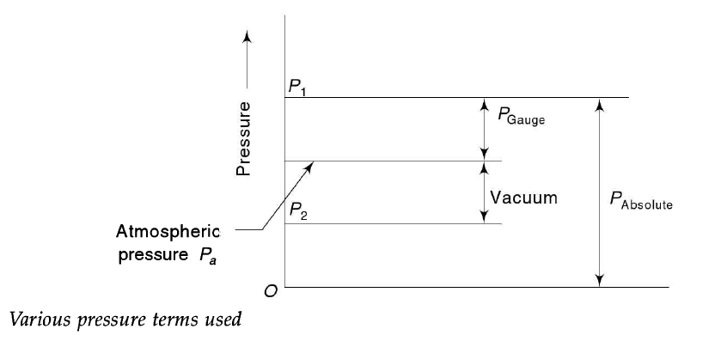
Absolute pressure transducers measure pressure relative to a perfect vacuum
Gauge pressure transducers measure pressure relative to atmospheric pressure.
Differential pressure transducers measure the difference in pressure between two points.

Slide 46
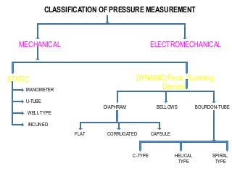
Dynamic
Static

Slide 47
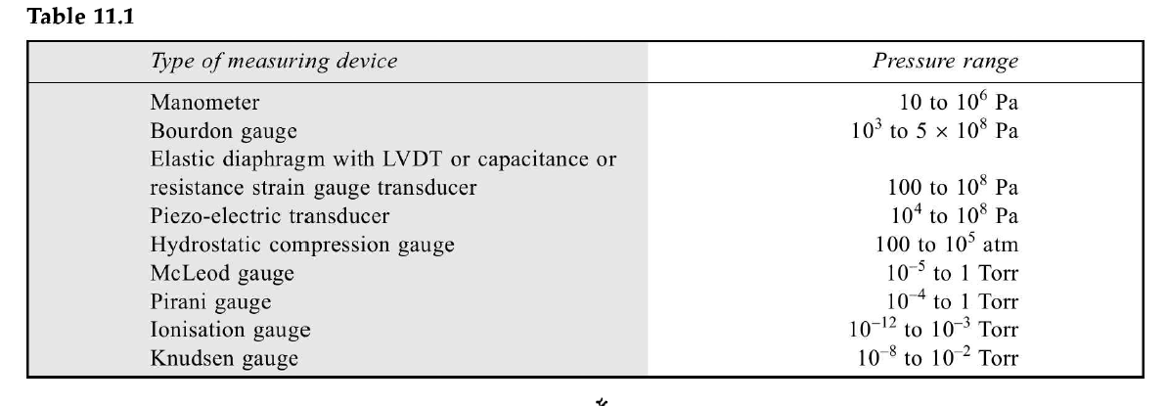

Slide 48

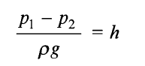
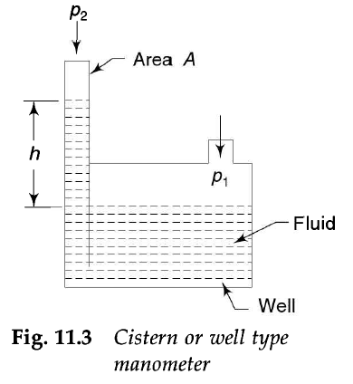
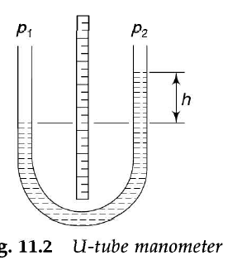
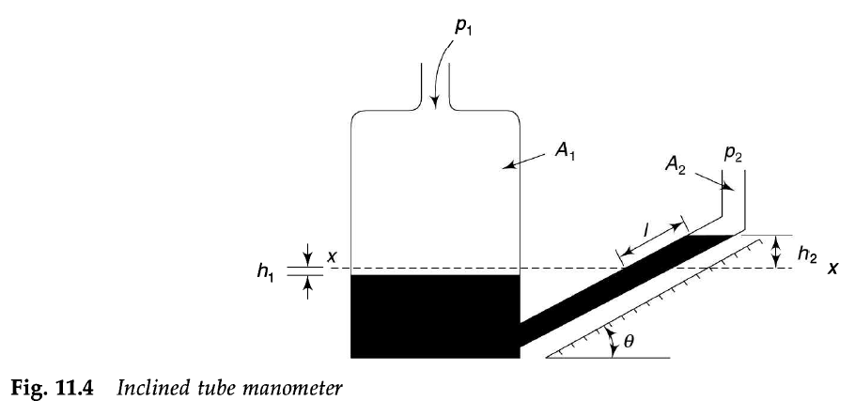
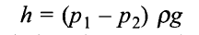
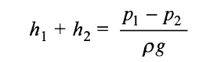

Slide 49
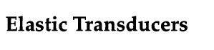
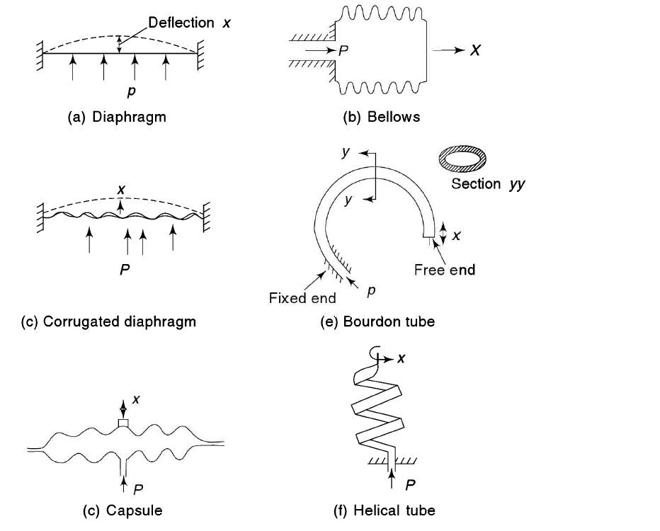

Slide 50
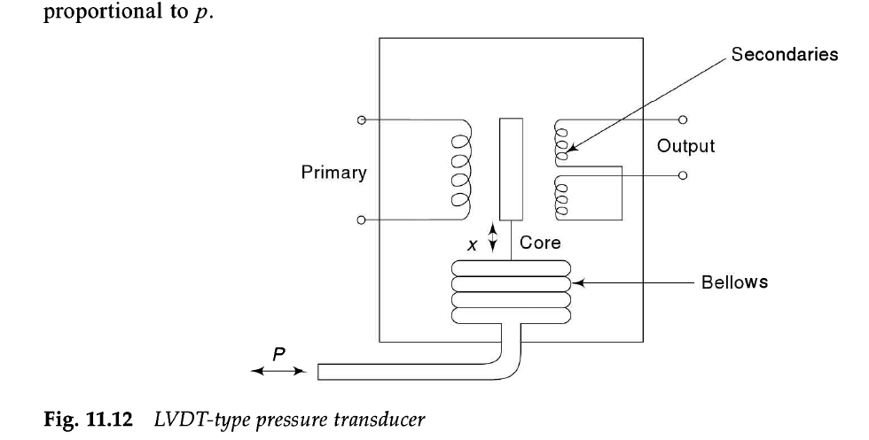
Pressure Transducers: Mechanical/Electromechanical

Slide 51


Pressure Transducers: Electrical

Slide 52
Low Pressure Measurement Transducers:
Thermal conductivity Gauge or Pirani Gauge

Slide 53
Temperature Transducers
A Temperature Transducer is a device that converts the thermal quantity into any physical quantity such as mechanical energy, pressure and electrical signals etc.
Application:
Automotive
Aerospace
Food processing
HVAC systems.

Slide 54


Temperature Measurement Methods
Temperature Measurement: Non Electrical

Slide 55

Temperature Scales

Slide 56
Non-Electrical Methods:
Bimetallic Thermometer: -30 to 550℃ with +/- 0,5 to 1% Inaccuracies
Bimetallic temperature sensors consist of two different metals with different thermal expansion coefficients, bonded together. They bend when heated, and the amount of bending is proportional to the temperature change.
They are commonly used in household thermostats and other low-temperature applications.

Slide 57



Slide 58



Slide 59


Pressure thermometers, also known as Bourdon tube thermometers, are devices used to measure temperature based on the principle of thermal expansion of materials. They consist of a sealed, curved tube made of a temperature-sensitive material, such as brass, copper, or beryllium copper. The tube is closed at one end and open at the other.
As the temperature changes, the material in the tube expands or contracts, causing the tube to straighten or bend. The degree of bending is proportional to the temperature and can be read using a dial or other display mechanism attached to the tube.

Slide 60

Pressure thermometers are commonly used in industrial applications where high accuracy and reliability are required. They are also used in laboratory settings for temperature measurements in gases and liquids.

Slide 61


Electrical Methods: RTD
Resistance Temperature Detectors (RTDs): These are made of metals such as platinum, copper, or nickel and their resistance increases with temperature. By measuring the change in resistance, the temperature can be determined.

Slide 62

Metallic Resistance Thermometer(RTD): Analysis

Slide 63

RTD: Lead Compensation

Slide 64

Semiconductor Transducers Thermistors
Thermistors: These are made of ceramic or semiconductor material and their resistance decreases with an increase in temperature. By measuring the change in resistance, the temperature can be determined.

Slide 66
Applications of Thermistors
Digital thermometers (thermostats)
Automotive applications (to measure oil and coolant temperatures in cars & trucks)
Household appliances (like microwaves, fridges, and ovens)
Circuit protection (i.e. surge protection)
Rechargeable batteries (ensure the correct battery temperature is maintained)
To measure the thermal conductivity of electrical materials
Useful in many basic electronic circuits (e.g. as part of a beginner Arduino starter kit)
Temperature compensation (i.e. maintain resistance to compensate for effects caused by changes in temperature in another part of the circuit) Used in wheatstone bridge circuits

Slide 67

3.Thermistor Specifications

Slide 68
Thermocouples:
These are made of two dissimilar metals that generate a voltage when heated. The voltage generated is proportional to the temperature difference between the hot junction and the cold junction of the thermocouple.

Slide 69


Slide 70
Thermocouples: Law

Slide 71
Thermocouples: Law

Slide 72

Thermocouples: Charateristics

Slide 73

Thermocouples: Specifications

Slide 74

Thermocouples: Types

Slide 75


Slide 76



Zener Diode Type

Slide 77

Comparisons RTD/Thermistor/TC/IC sensors

Slide 78
Numerical on Temperature Measurement

Slide 79
Thermistor
1.For a certain thermistor β = 3100 K and its resistance at 20°C is known to be 1050 Ω. The thermistor is used for temperature measurement and the resistance measured is 2300 Ω. Find the measured temperature.Temperture in kelvin
Ans: T=272.8 K=0c

Slide 80
EX: A thermistor has R0=2000 Ω at T0=300K, If β=4000k Determine resistance at - 75,-25 0 75, 25 and 100 ℃ . Also plot response
EX:A thermistor has a nominal resistance of 10 kΩ at 25 ℃. To evaluate the thermistor, the resistance at 0^{C} is measured as 29.49 kΩ. Calculate and plot the resistance of the thermistor between -50 and + 50 ℃

Slide 81
RTD
A Platinum RTD has resistance of 100 Ω at 25 ℃. Find its resistance at 50 ºC the temperature coefficient of platinum is 0.00392Ω/Ω 0 ⁰C. If the thermometer has a resistance of 200Ω calculate value of temperature.
Ans: 280 ^{O}C

Slide 83

Bimetallic Thermometer

Slide 84

Thermocouple

Slide 85
THANK YOU

